Slide 1

Sentiment Analysis Based on Text_
BIGDATA PROJECT:
S M Rakib Hasan
Jana Bodvanski
Abdullah Qureshi
Riaz Uddin Rafel
06/05/2025

Slide 2
Table of contents_
Objectives
Datasets and Data Collection
Exploratory Data Analysis
ML Models Training
Bag of Words (with Multinomial Naive-Bayes)
TF-IDF + Logistic Regression
LSTM
BERT
Evaluation of Results with Test Dataset
Comparison of Models
Conclusions

Slide 3
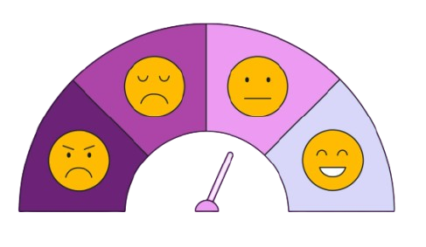
Objectives_
The goal of this project is to:
Collect and preprocess open-source text datasets containing labeled emotion categories
Create custom dataset
Train a ML model to classify text data into distinct emotional categories (e.g., happiness, sadness, anger, fear, surprise) based on sentiment cues.
Analyze and test the results on the open-source dataset

Slide 4
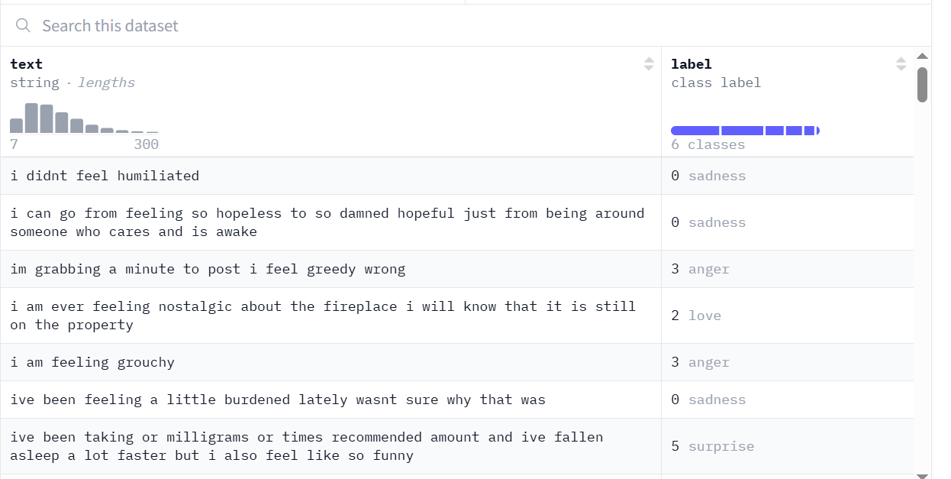
Dataset Used
Emotions Dataset
Emotion is a dataset of English Twitter messages with six basic emotions:
Anger, fear, joy, love, sadness, and surprise
Source: https://github.com/dair-ai/emotion_dataset

Slide 5
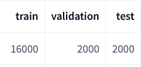
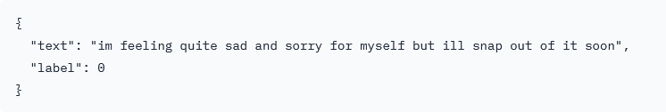
Dataset Used
Emotions Dataset
Example
Text: a string feature.
Label: a classification label, with possible values including sadness (0), joy (1), love (2), anger (3), fear (4), surprise (5).

Slide 6





Dataset Used
Data Classes
Data is classified into 5 distinct classes:
0: Sadness
1: Joy
2: Love
3: Anger
4: Fear

Slide 7

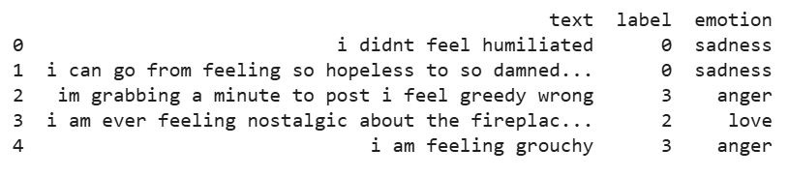
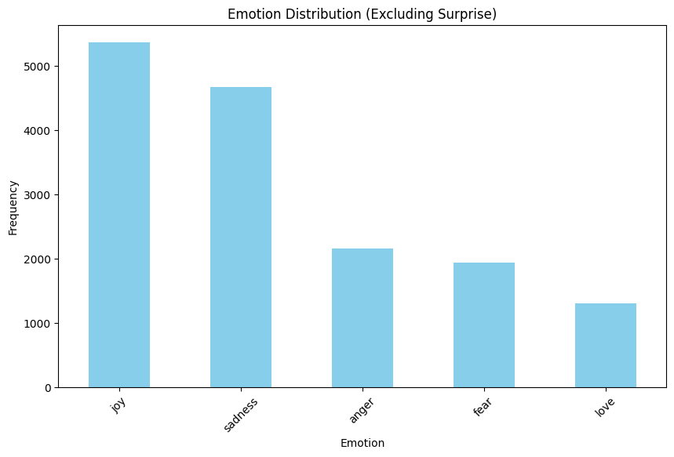
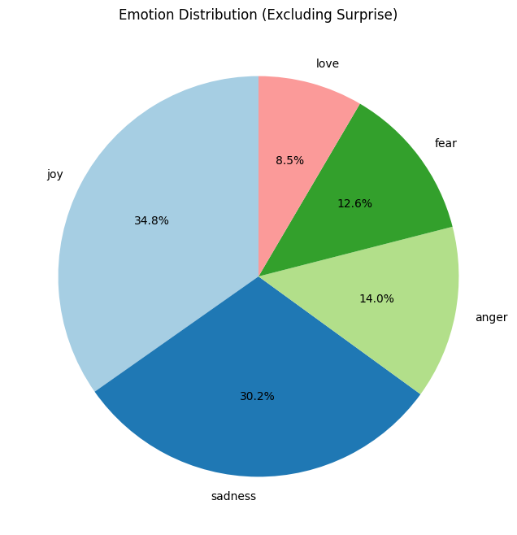
Data Visualization
Python Notebook

Slide 8
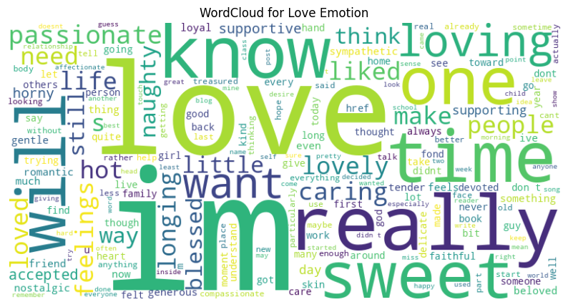
Data Visualization

Slide 9
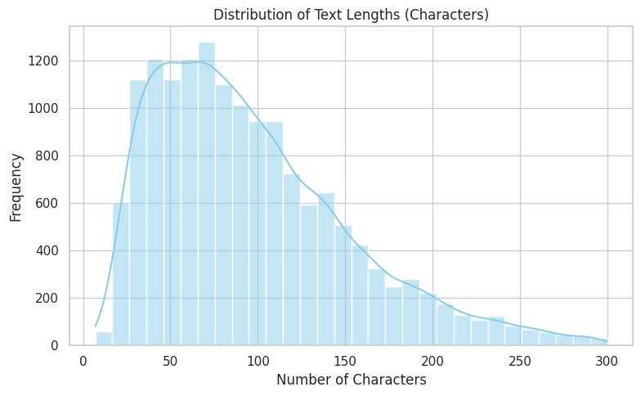
Data Visualization

Slide 10
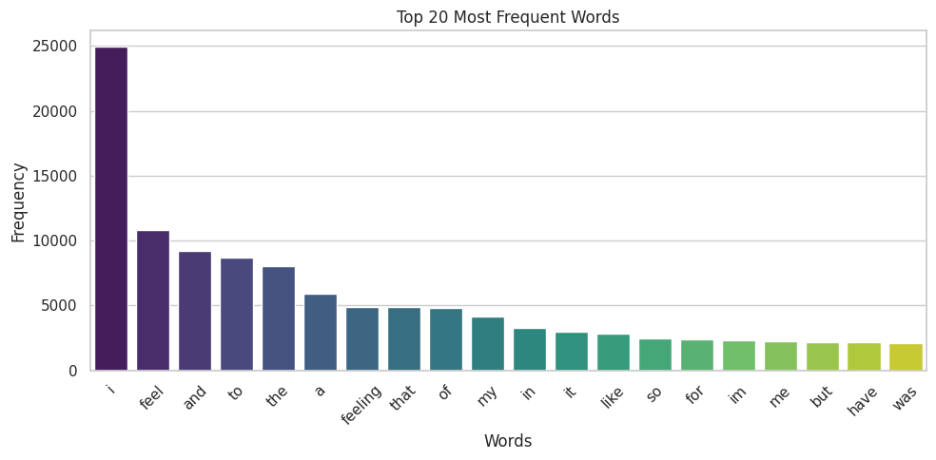
Data Visualization
Total words: 295,238
Unique words: 14,917

Slide 11
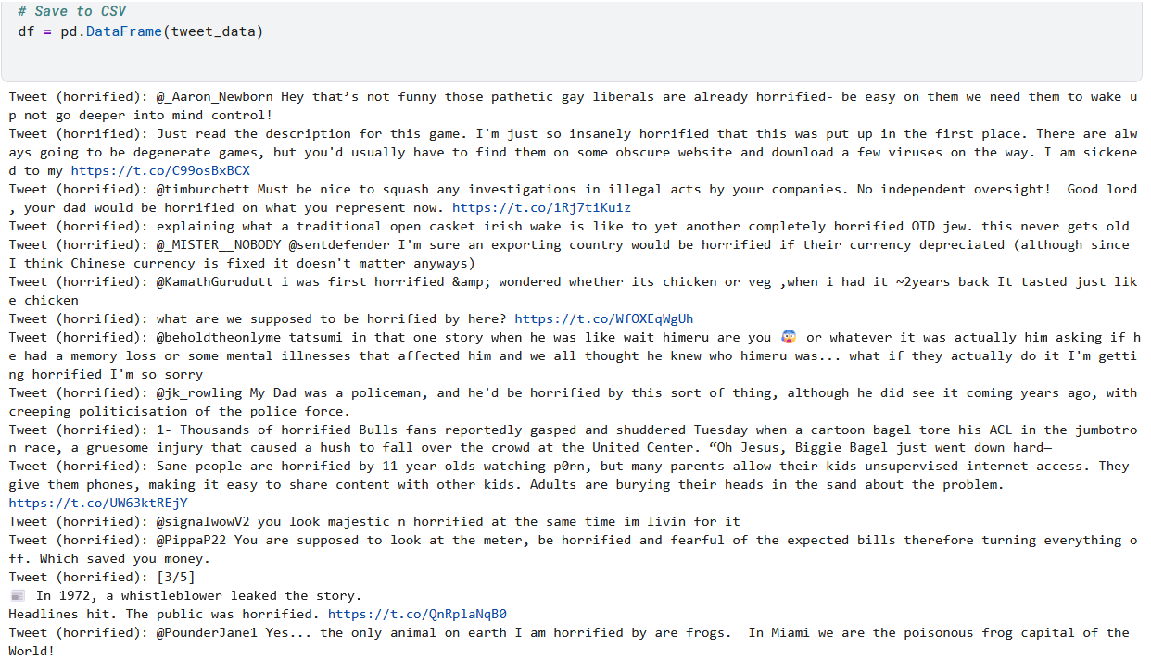

Data Collection from X
Python Notebook
Using X API to collect text data from Twitter with Specific Keyword.

Slide 12
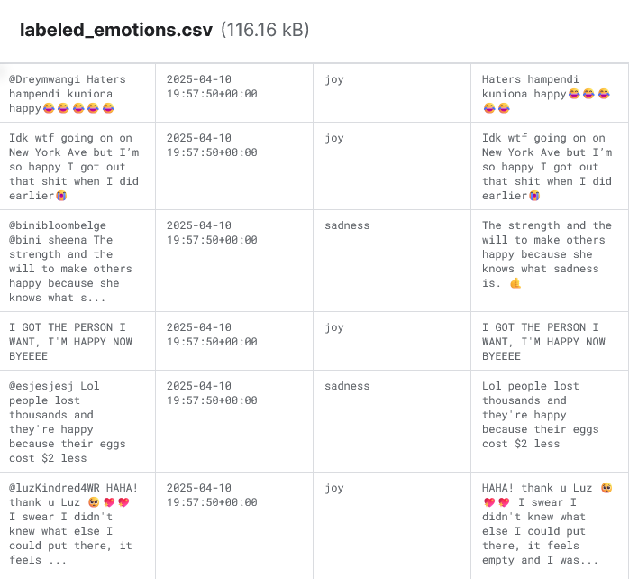
Custom Dataset
Python Notebook
Cleaning and Labeling the datasets with LLM
Uploaded and available on Kaggle: https://www.kaggle.com/code/hasanccr92/custom-dataset-preparation

Slide 13
Model Training_

Slide 14
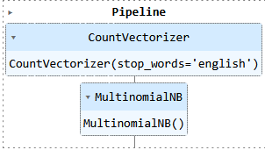
Bag of Words + Naive Bayes
Python Notebook
Bag of Words (BoW): Represents text as a collection of word counts or frequencies, ignoring word order and grammar, to create numerical features for text analysis.
CountVectorizer: Transforms text into a sparse matrix of word counts, capturing the frequency of each word in the vocabulary for feature extraction.
Multinomial Naive Bayes: A probabilistic classifier that uses word frequencies to predict class probabilities, suitable for discrete data like word counts in text classification.

Slide 15
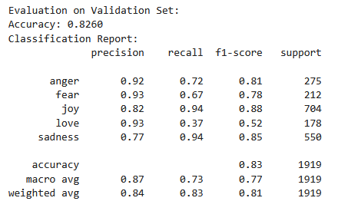
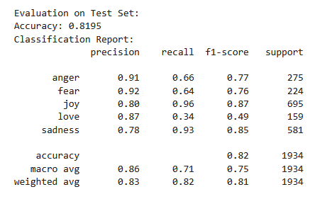
Bag of Words + Naive Bayes
Accuracy: 81.95%

Slide 16
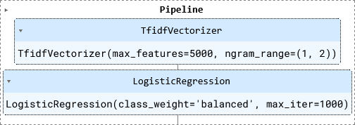
TF-IDF + Logistic Regression
Python Notebook
Train model using TF-IDF Vectorizer and Logistic Regression
TF-IDF (Term Frequency-Inverse Document Frequency) transforms text into numerical features based on word importance for feature extraction
Logistic Regression for classification

Slide 17
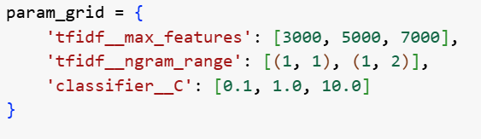
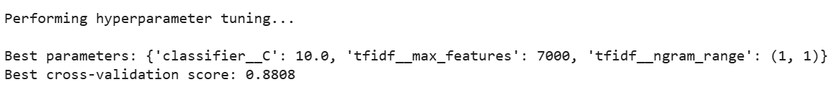
TF-IDF + Logistic Regression
Python Notebook
Grid Search for
TF-IDF Max features
Regularization strength of Classifier

Slide 18
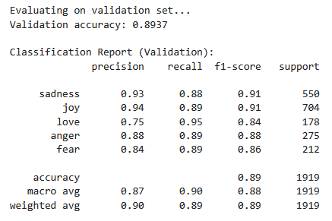
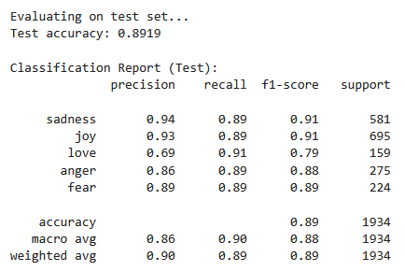
TF-IDF + Logistic Regression
Accuracy: 89.19%

Slide 19
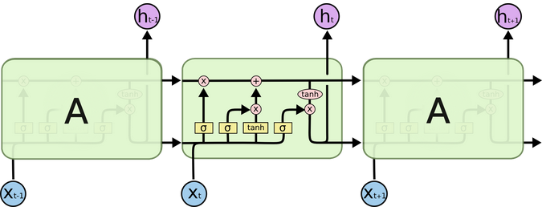
LSTM
Python Notebook
Bidirectional LSTM: Processes text in both forward and backward directions, capturing long-range dependencies and context for better emotion understanding.
Embedding Layer: Converts words into dense vectors, preserving semantic relationships and improving model learning.
Sequence Processing: Unlike Bag-of-Words, LSTM retains word order, making it better at detecting nuanced emotions in text.
Source:https://colah.github.io/posts/2015-08-Understanding-LSTMs/

Slide 20
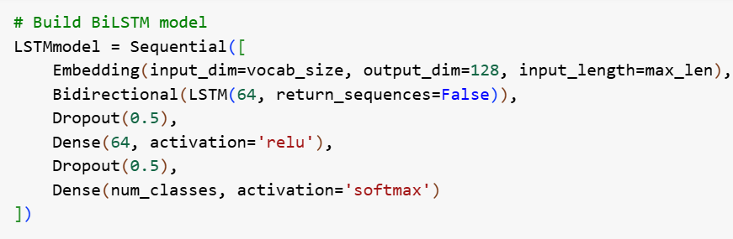
Training LSTM
Python Notebook
Embedding Layer: Converts word indices to dense 128D vectors.
Bidirectional LSTM (64 units): Processes input both forward and backward, outputting a 128D vector (64×2). Captures full context of the sequence.
Dropout (0.5): Prevents overfitting by randomly deactivating 50% of neurons.
ReLU activation: Learns non-linear combinations of BiLSTM features.
Dropout (0.5): Additional regularization.
Early Stopping is used if validation loss doesn’t improve for 3 epochs.
Device: Tesla P100-PCIE-16GB

Slide 21
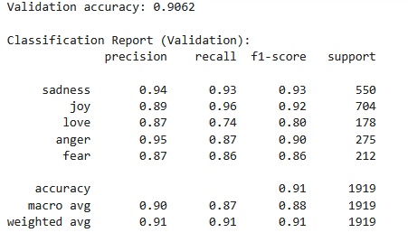
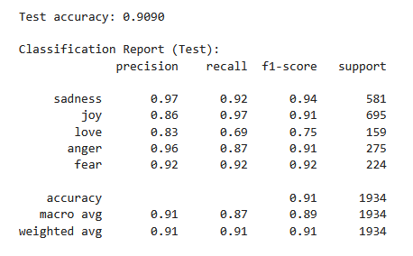
LSTM Results
Accuracy: 90.9%

Slide 22
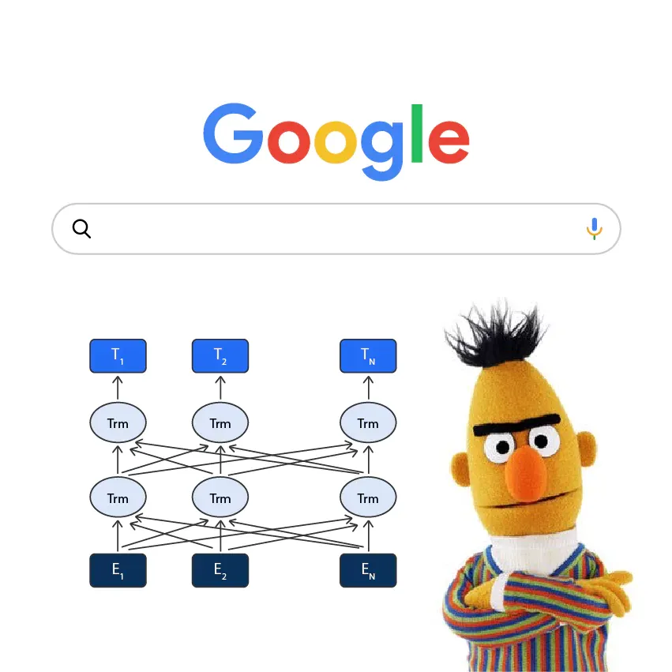
BERT
Python Notebook
(Bidirectional Encoder Representations from Transformers)
Language learning model based on the transformer architecture, designed to understand the full context of words in a sentence by looking both left and right
BERT reads sentences bidirectionally, meaning it looks at the full context (both before and after each word) - for example:
"I'm fine" vs. “I'm fine, I guess..." BERT can understand the emotional difference
It is pre-trained on a massive amount of text (Wikipedia, books), so it already understands grammar, word relationships, and general language structure

Slide 23

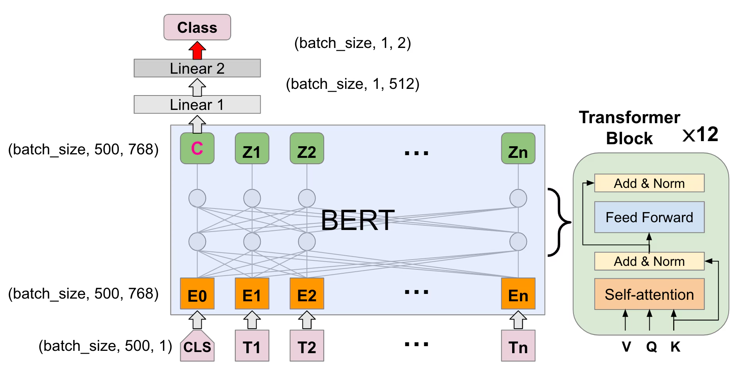
BERT
Used in Training:
Model: BERT base model (uncased)
Parameters: 110M
Device: Tesla P100-PCIE-16GB
Framework: PyTorch
Epoch: 5
Optimizer: Adam
Source: https://www.splunk.com/en_us/blog/security/deep-learning-in-security-text-based-phishing-email-detection-with-bert-model.html

Slide 24
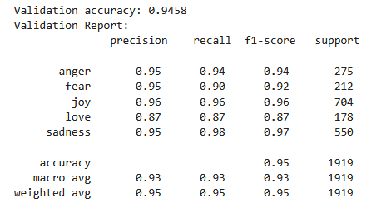
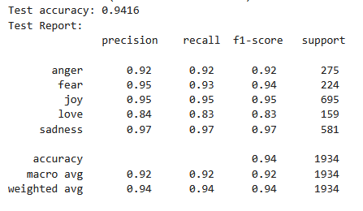
BERT Results
Accuracy: 94.16%

Slide 25
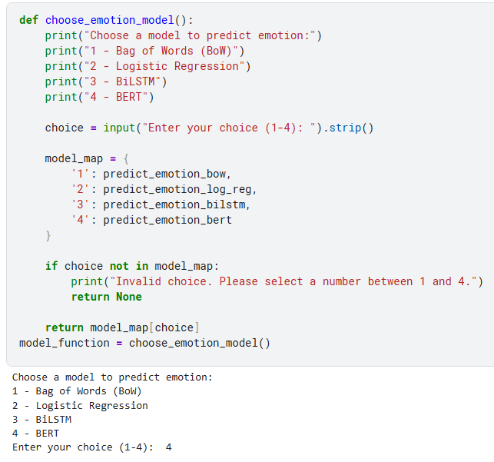
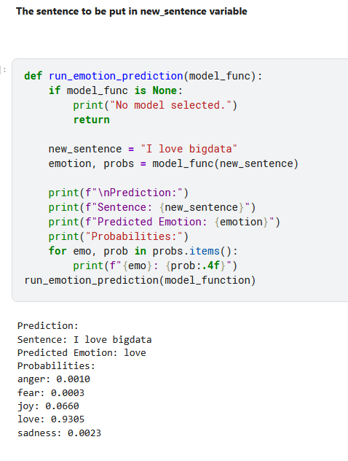
Using in a Real Case
Taking any model of choice
Predicted Class

Slide 26
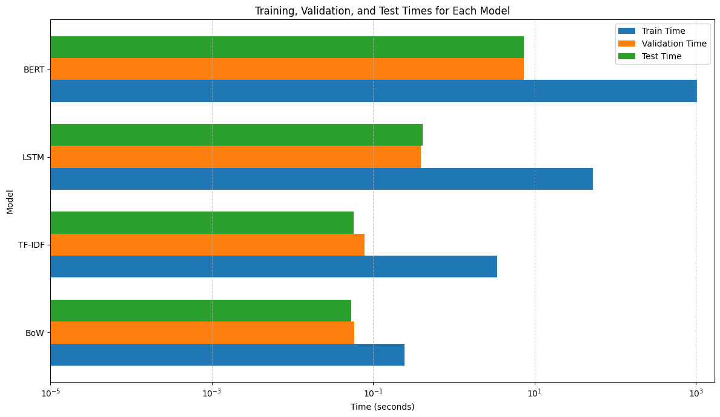
Evaluation of Different Models
Training, Validation and Test times

Slide 27
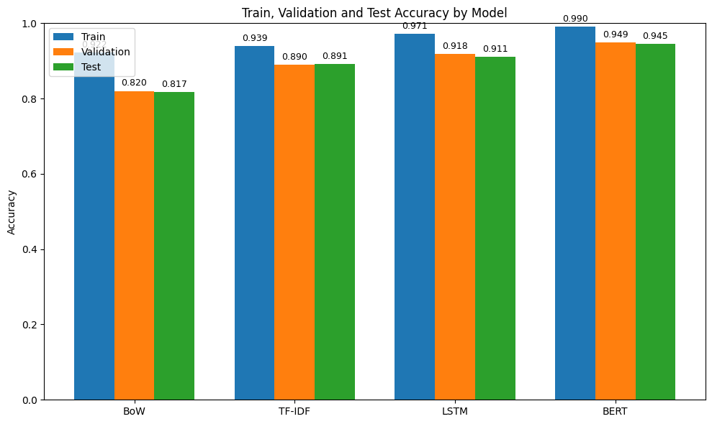
Evaluation of Different Models
Training, Validation and Test accuracy

Slide 28
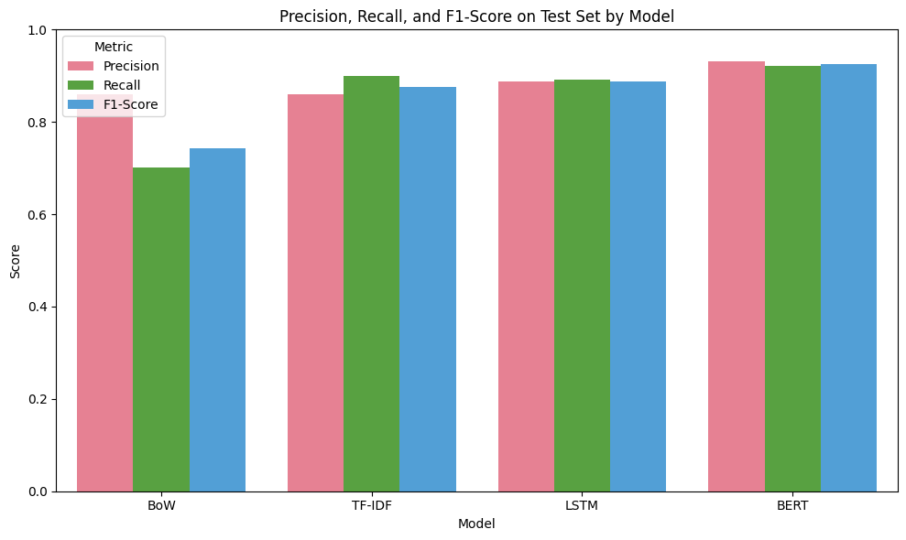
Evaluation of Different Models
Precision, Recall and F1 score

Slide 29
Evaluation of Different Models
Precision, Recall and F1 score

Slide 30
Model Comparison_
Python Notebook
Model | Accuracy (Test Set) | Train Time | Evaluation Time (Validation) | Evaluation Time (Test)
Multinomial Naive Bayes | 81.75 % | 0.2434 s | 0.0537 s | 0.0577 s
TF-IDF + Logistic Regression | 89.14 % | 3.1797 s | 0.0473 s | 0.0422 s
LSTM | 91.05 % | 52.94 s | 0.3892 s | 0.4104 s
BERT | 94.16 % | 1036.77 s | 7.3389 s | 7.4037 s

Slide 31
Model Comparison_
Model | How It Processes Text | Context Capture | Training Requirements (Hardware/Time/Memory)
Multinomial Naive Bayes | Converts text into word counts, ignoring order and grammar. Uses CountVectorizer. | No context (order ignored) | Very Fast, low-resource (CPU). Minimal memory.
TF-IDF + Logistic Regression | Weights words by importance (TF-IDF), then applies linear classification. | Limited (no word order) | Fast, CPU-efficient. Low memory.
LSTM | Processes sequences bidirectionally with embeddings. Retains word order. | Moderate (captures local + long-range dependencies) | GPU preferred. Moderate time/memory.
BERT | Uses self-attention to analyze full context bidirectionally. Pre-trained on vast text. | Excellent (understands nuance, e.g., "I’m fine" vs. "I’m fine...") | Heavy GPU usage. Slow training, high memory.

Slide 32
Conclusion_
BERT has the highest accuracy from all models (94.16%) in emotion classification, followed by LSTM at 91.05%
BERT and LSTM excel in capturing contextual nuances but demand significant computational resources
Models like BERT and LSTM effectively handle complex sentiment cues by preserving word order and context while other traditional model like Naive Bayes overlooks these sequential relationships.
Naive Bayes and TF-IDF are faster and less resource-intensive.
The selection of the model depends on the computational resources that are available and the level of accuracy required

Slide 33
Thanks!_
Do you have any questions?

